Slide 1

SFM and 3D reconstruction from scratch
Computer Vision 2023-2024
Authors: Giada Piacentini, Giada Troilo and Simone Cargnin

Slide 2
Outline
Introduction
Proposed methods
Dataset
Implementation details
Results
Conclusion and Future Works

Slide 3
Introduction
Create a 3D mesh from a 2D image

Slide 4
Introduction
Create a 3D mesh from a 2D image
Images
Different perspective
Sequential
RGB format

Slide 5
Introduction
Create a 3D mesh from a 2D image
Images
Different perspective
Sequential
RGB format
Camera calibration
Checkboard images
Calculate intrinsic parameters

Slide 6
Introduction
Camera calibration
Images
Point Cloud
3D meshes
Create a 3D mesh from a 2D image
Images
Different perspective
Sequential
RGB format
Camera calibration
Checkboard images
Calculate intrinsic parameters

Slide 7
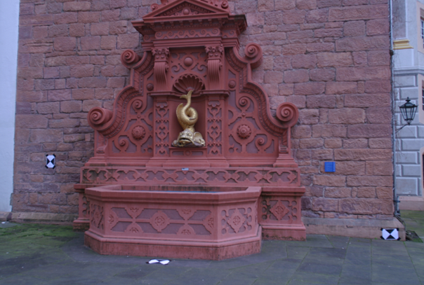
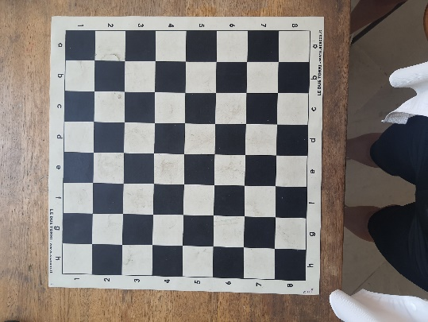

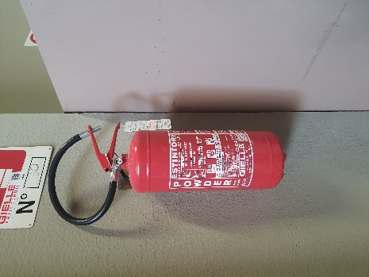
Proposed method:
CAMERA CALIBRATION
SFM
POINT
CLOUD
3D MESH
checkboard
3D RECONSTRUCTION
object

Slide 8



Datasets
Benchmarking_Camera_Calibration_2008 Dataset
(Fountain-P11)
9 images
Intrinsic parameters of the camera
Fire estinguisher
Dataset created by us
4 images
Intrinsic parameters
Checkboard
14 images

Slide 9

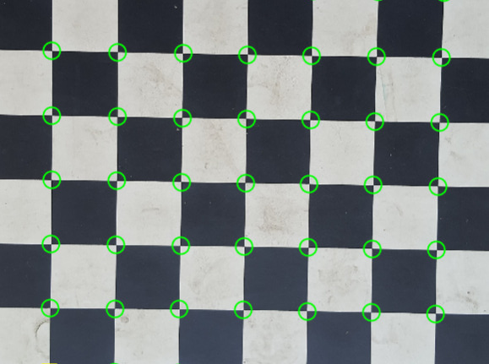
Camera calibration
Given:
10-15 photos of a checkboard
The size of the squares on the checkboard
We get the intrinsic parameters of the camera:
Focal lenght
Optical center of the camera
Projection matrix (k)
fx | 0 | cx
0 | fy | cy
0 | 0 | 1
Detected corners

Slide 10
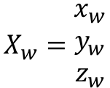




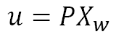
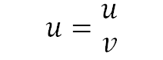
Camera calibration algorithm what is known?
u
3D coordinates in real-world
Extrapolated from the cell size
v
2D coordinates of the scene
$$X_{w}=\begin{matrix}x_{w} \\ y_{w} \\ z_{w}\end{matrix}$$
$$u=\begin{matrix}u \\ v\end{matrix}$$
z_{w}
$$u=PX_{w}$$
x_{w}
y_{w}

Slide 11
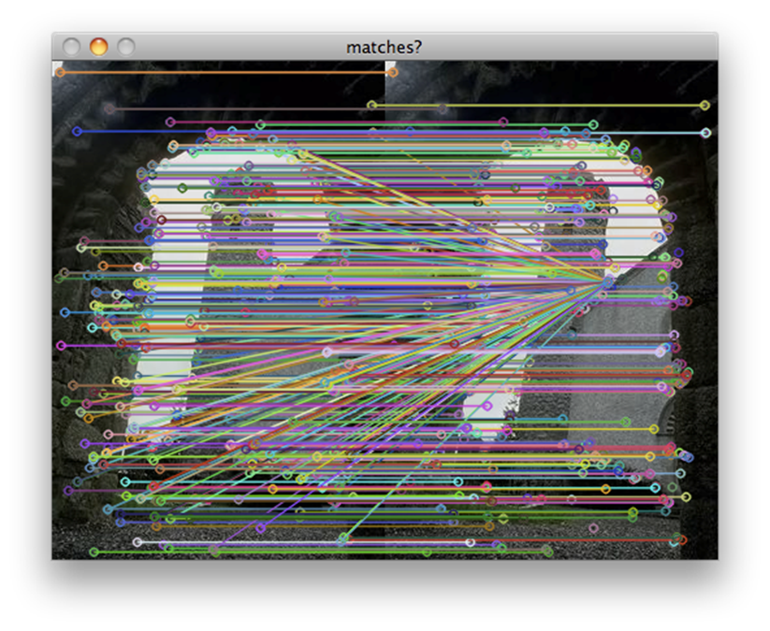

Camera calibration algorithm
How to find k
know
unknow
know
$$\left(\begin{aligned}u^{(i)} \\ v^{(i)} \\ 1\end{aligned}\right)=\left(\begin{matrix}p_{11} \\ p_{21} \\ p_{31}\end{matrix} \begin{matrix}p_{12} \\ p_{22} \\ p_{32}\end{matrix} \begin{matrix}p_{13} \\ p_{23} \\ p_{33}\end{matrix} \begin{matrix}p_{14} \\ p_{24} \\ p_{34}\end{matrix}\right)\left(\begin{aligned}x_{w}^{(i)} \\ y_{w}^{(i)} \\ z_{w}^{(i)} \\ 1\end{aligned}\right)$$
We solve it for P

Slide 12
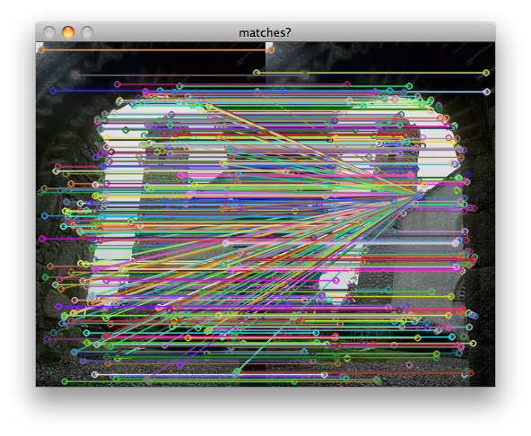
Feature extraction and mathing
Features are extracted using Sift detector
The matches are made using the Sift descriptors
Matches are further refined using ransac algorithm to remove outliers

Slide 13
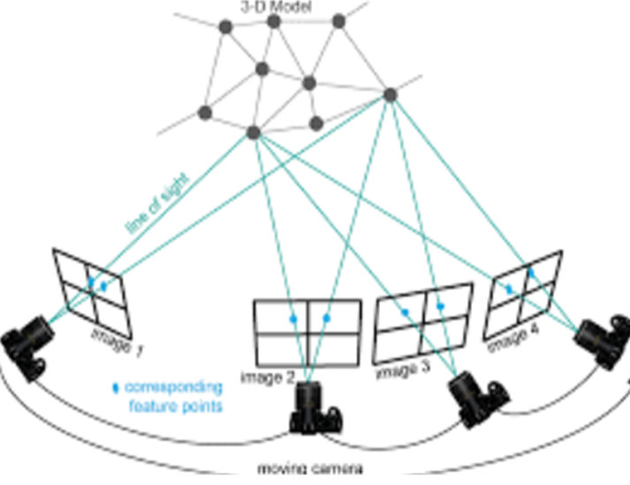
Feature extraction and mathing
Features are extracted using Sift detector
The matches are made using the Sift descriptors
Matches are further refined using ransac algorithm to remove outliers

Slide 14
SFM – Steps for the first image
View 1 and
View 2
Baseline pose
Matches
Triangulation
Intrinsic matrix K
Camera disambiguation
Camera pose estimation
compute essential matrix using PnP ransac, estimate the object pose
2.camera disambiguation
3. Decomposition of the essential matrix in rotation and translation
4. Triangulation

Slide 15
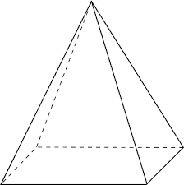



Baseline Pose
Removing outliers using the fundamental matrix F
Computing the essential matrix E from F and the camera intrinsic matrix K
Decomposes the essential matrix E into four possible solutions for rotation and translation
Triangulating points and evaluating reprojection errors to select the best pose
F
Essential Matrix
Select the best pose
$$E=K^{T}FK$$

Slide 16
SFM – Steps for the other images
Pnp -> Perspective n point algorithm
Views
Pnp Ransac
Matches
Triangulation
Intrinsic matrix K
Ransac is used to make the algorithm
more robust to outliers
Camera pose estimation
compute essential matrix using PnP ransac, estimate the object pose
2.camera disambiguation
3. Decomposition of the essential matrix in rotation and translation
4. Triangulation

Slide 17
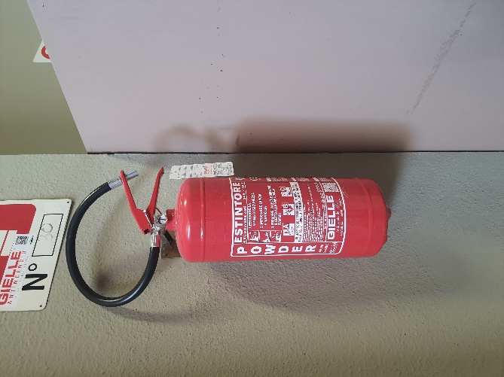
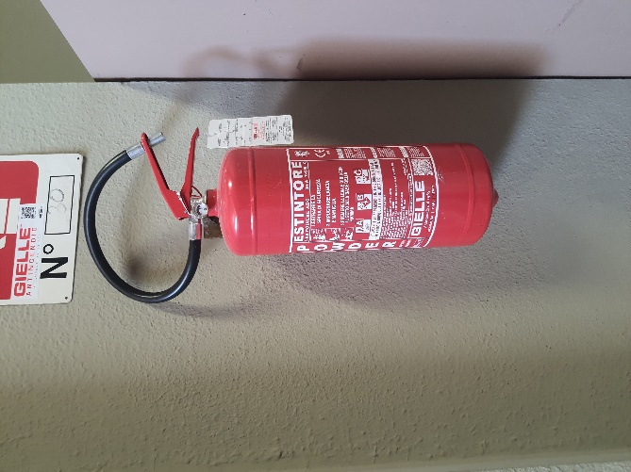
Triangulation
3D POINT
Left image
x
x’
Right image
C
C’
Left camera with matrix P
Right camera with matrix P’

Slide 18
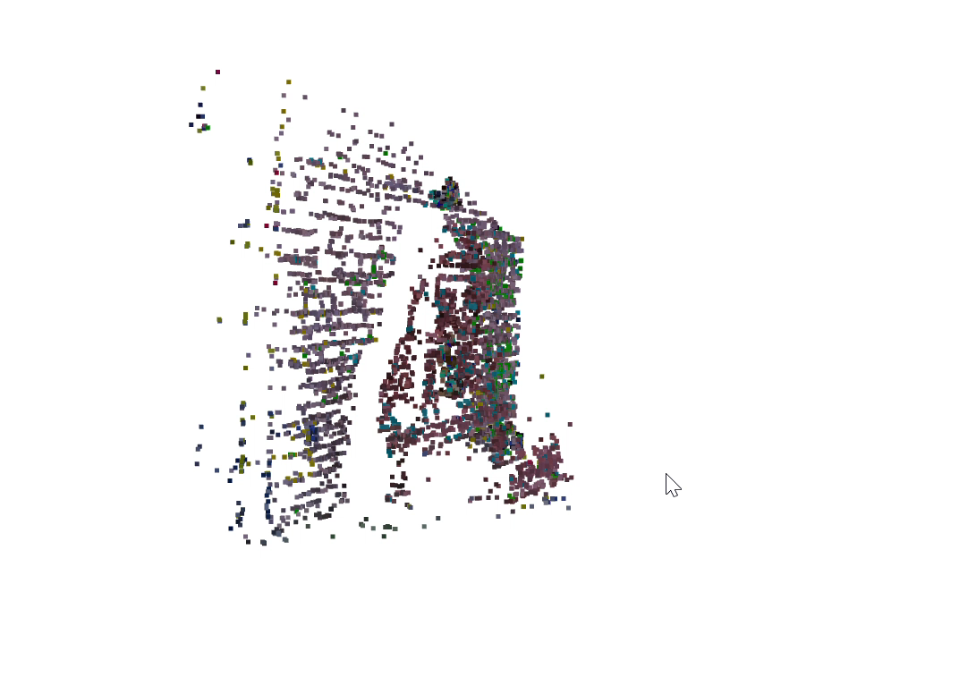

Results - Point Cloud
Fountain-P11

Slide 19
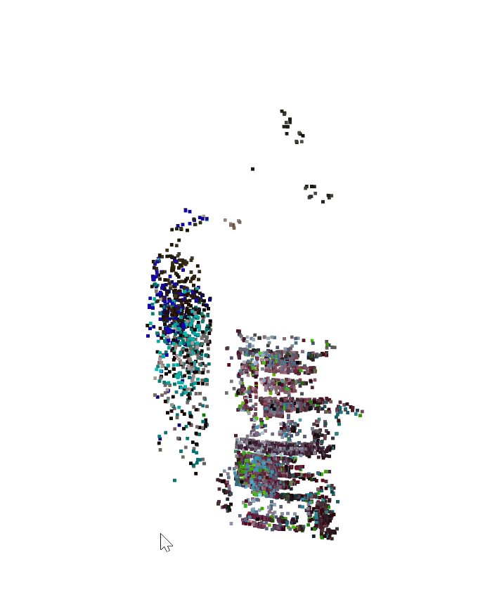
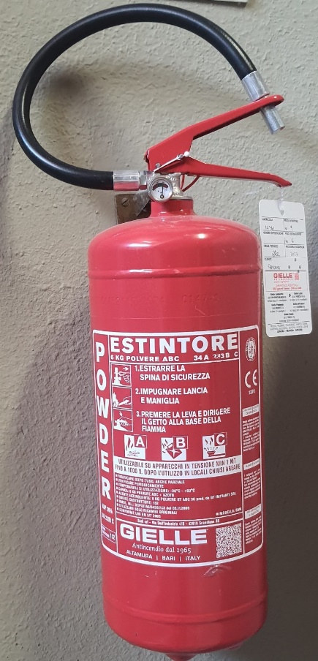
Results - Point Cloud
Fire extinguisher

Slide 20

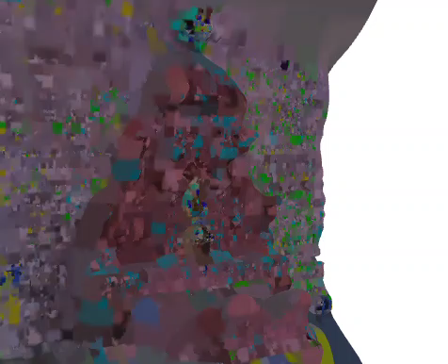
Results - 3D Mesh
POISSON
Fountain-P11

Slide 21
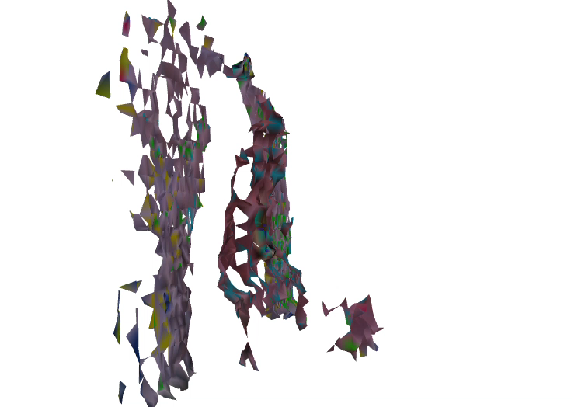
Results - 3D Mesh
ALPHA SHAPES
Fountain-P11

Slide 22
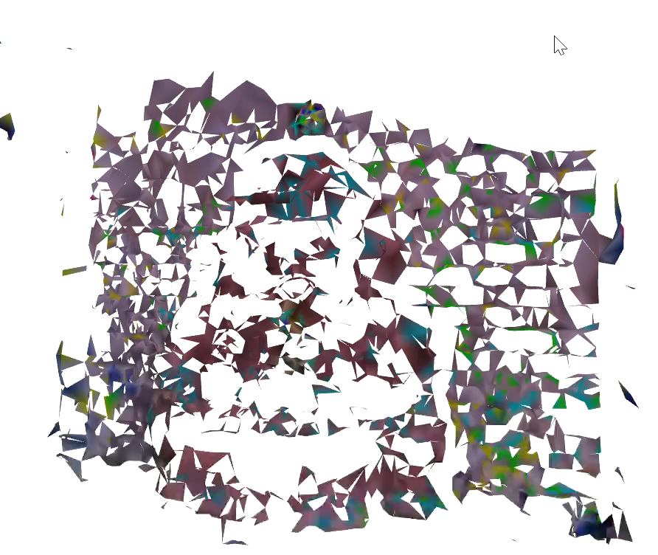
Results - 3D Mesh
BALL PIVOTING
Fountain-P11

Slide 23
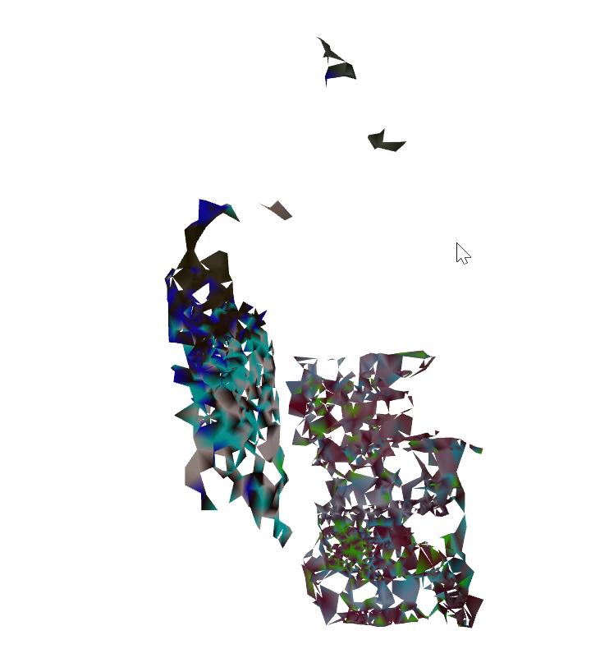
Results - 3D Mesh
BALL PIVOTING
Fire_Extinguisher

Slide 24
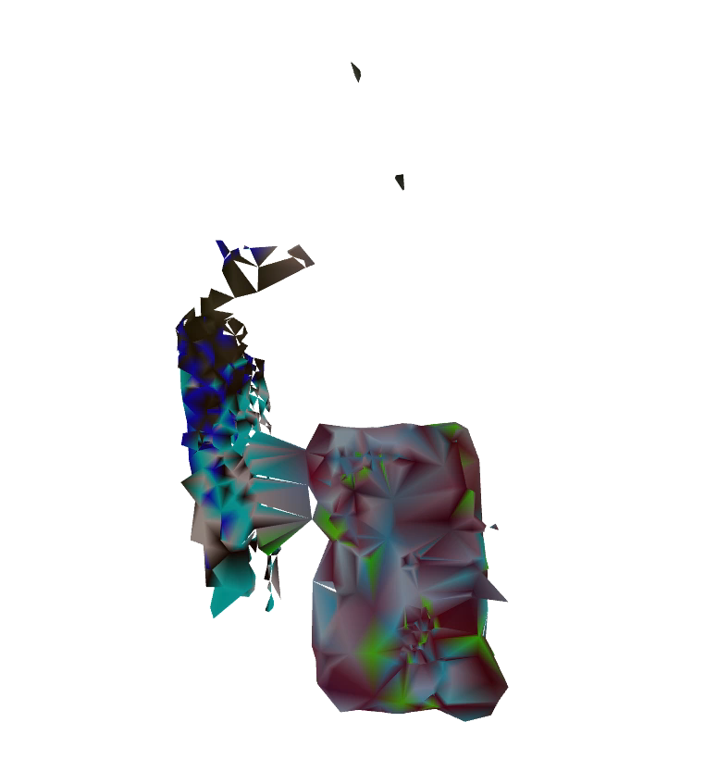
Results - 3D Mesh
ALPHA SHAPES
Fire_Extinguisher

Slide 25
Fountain vs Fire Extinguisher
INFO:root:Mean reprojection error for 1 image is 4.748986
INFO:root:Mean reprojection error for 2 images is 4.915440
INFO:root:Mean reprojection error for 3 images is 2.456163
INFO:root:Mean reprojection error for 4 images is 3.103855
INFO:root:Mean reprojection error for 5 images is 2.925984
INFO:root:Mean reprojection error for 6 images is 1.679555
INFO:root:Mean reprojection error for 7 images is 2.075949
INFO:root:Mean reprojection error for 8 images is 1.762192
INFO:root:Mean reprojection error for 9 images is 2.555154
INFO:root:Mean reprojection error for 1 image is 13.848791
INFO:root:Mean reprojection error for 2 images is 11.451980
INFO:root:Mean reprojection error for 3 images is 4.613866
INFO:root:Mean reprojection error for 4 images is 35.247193
INFO:root:Mean reprojection error for 5 images is 91.109809

Slide 26
Conclusion and future works
Conclusion :
Analyzing our results, we can conclude that using more images leads to better performance. Objects with more details generate more keypoints, which in turn results in a higher quality point cloud.
Future works:
Optimize Triangulation: Use more sophisticated triangulation methods to improve the accuracy of 3D point computation.
Bundle Adjustment: Implement global and local bundle adjustment to refine the poses and 3D points. This step optimizes the entire reconstruction by minimizing the reprojection error across all images.

Slide 27


Authors
Piacentini Giada
piacentini.1907969@studenti.uniroma1.it
Troilo Giada
troilo.1889348@studenti.uniroma1.it
Cargnin Simone
cargnin.1940053@studenti.uniroma1.it

